Slide 1
Nonparametric Tests
Part 2

Slide 2
Sign Test (Non-parametric Test for Location)
Null hypothesis: the median of the distribution is some specified value (may or may not be zero).
Given a sample from the distribution, there should be roughly the same number of positive and negative values.
More precisely, number of positive values should follow a binomial distribution with probability 0.5.
When the sample is large, the binomial distribution can be approximated with a normal distribution

Slide 3
Assumptions for one sample sign test

Slide 4
Procedure to execute One Sample Sign Non Parametric Hypothesis Test

Slide 5
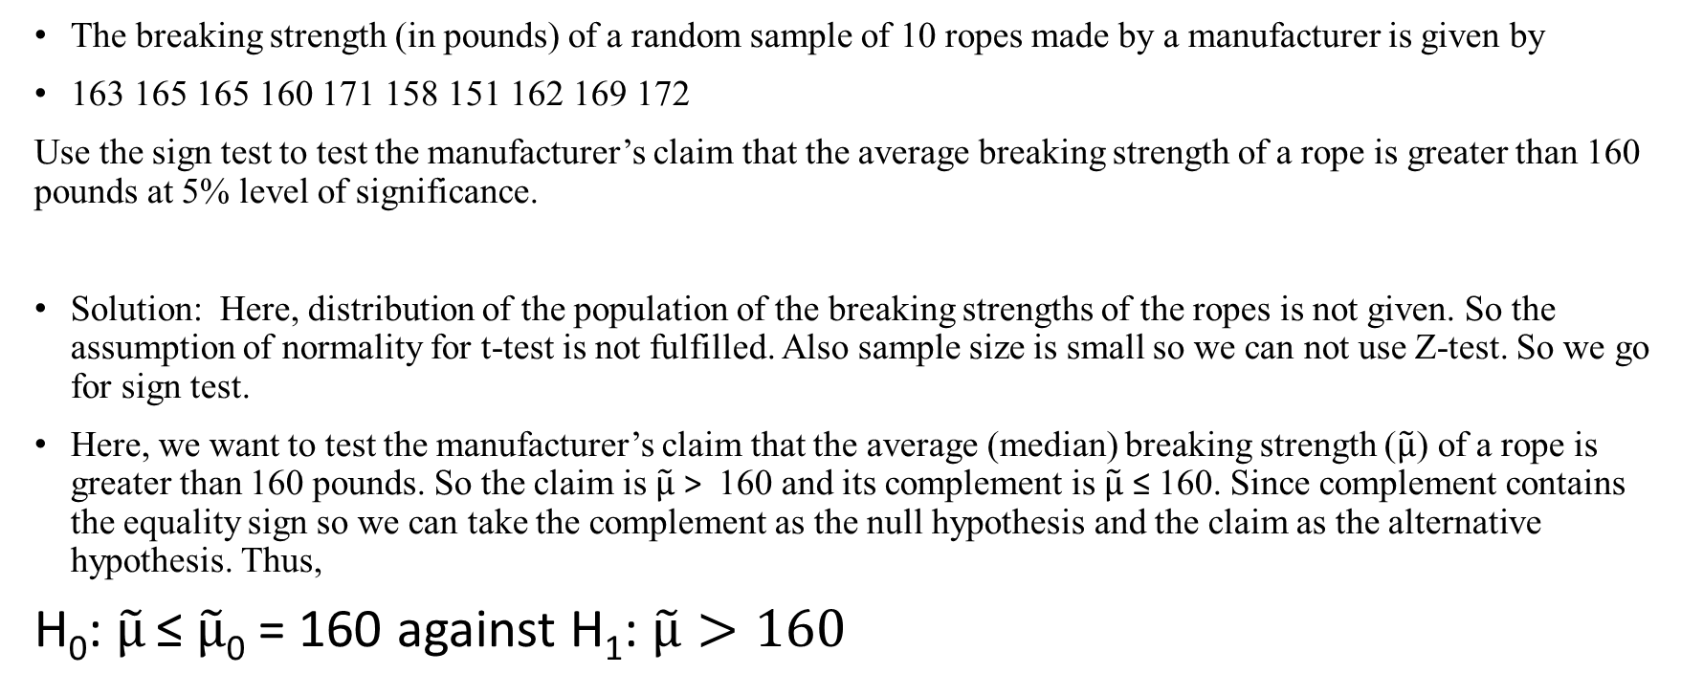
Example 1
The breaking strength (in pounds) of a random sample of 10 ropes made by a manufacturer is given by
163 165 165 160 171 158 151 162 169 172
Use the sign test to test the manufacturer’s claim that the average breaking strength of a rope is greater than 160 pounds at 5% level of significance.
Solution: Here, distribution of the population of the breaking strengths of the ropes is not given. So the assumption of normality for t-test is not fulfilled. Also sample size is small so we can not use Z-test. So we go for sign test.
Here, we want to test the manufacturer’s claim that the average (median) breaking strength ($\tilde{μ}$) of a rope is greater than 160 pounds. So the claim is $\tilde{μ}$ > 160 and its complement is $\tilde{μ}$ ≤ 160. Since complement contains the equality sign so we can take the complement as the null hypothesis and the claim as the alternative hypothesis. Thus,
H₀: $\tilde{μ}$ ≤ $\tilde{μ}$₀ = 160 αγαινστ Η₁: $\tilde{μ}>160$

Slide 6
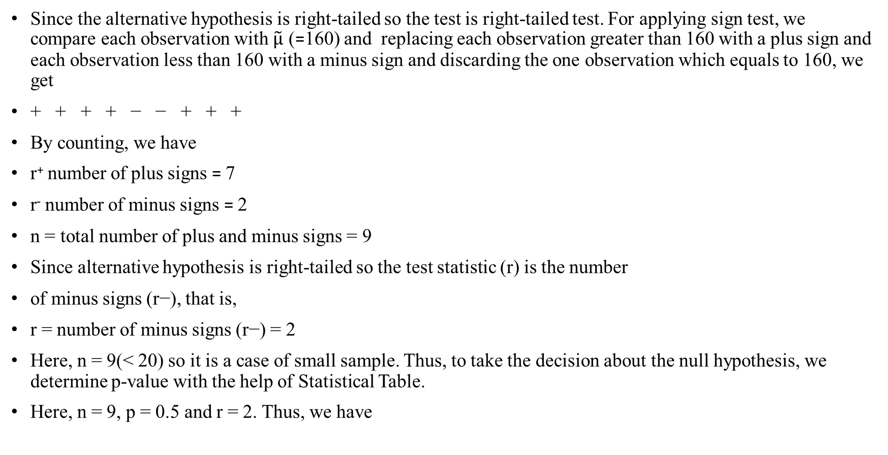
Since the alternative hypothesis is right-tailed so the test is right-tailed test. For applying sign test, we compare each observation with $\tilde{μ}$ (=160) and replacing each observation greater than 160 with a plus sign and each observation less than 160 with a minus sign and discarding the one observation which equals to 160, we get
+ + + + − − + + +
By counting, we have
r⁺ number of plus signs = 7
r⁻ number of minus signs = 2
n = total number of plus and minus signs = 9
Since alternative hypothesis is right-tailed so the test statistic (r) is the number
of minus signs (r−), that is,
r = number of minus signs (r−) = 2
Here, n = 9(< 20) so it is a case of small sample. Thus, to take the decision about the null hypothesis, we determine p-value with the help of Statistical Table.
Here, n = 9, p = 0.5 and r = 2. Thus, we have

Slide 7
p-value = P[r ≤ 2] = 0.090
Since p-value = 0.0899 > 0.05, So we do not reject the null hypothesis and reject the alternative hypothesis i.e. we reject the manufacturer’s claim at 5% level of significance.
Thus, we conclude that the sample provide us sufficient evidence against the claim so manufacturer’s claim that the breaking strength of a rope is greater than 160 pounds is not true.

Slide 8
Example 2
Bank of America West Palm Beach, FL branch manager indicates that the median number of savings account customers per day is 64. A clerk from the same branch claims that it was more than 64. Clerk collected the number of savings account customers per day data for 10 random days. Can we reject the branch manager’s claim at 0.05 significance level?

Slide 11
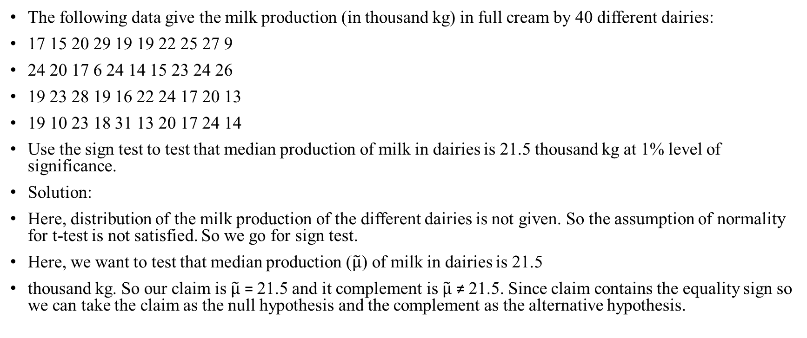
Example 3
The following data give the milk production (in thousand kg) in full cream by 40 different dairies:
17 15 20 29 19 19 22 25 27 9
24 20 17 6 24 14 15 23 24 26
19 23 28 19 16 22 24 17 20 13
19 10 23 18 31 13 20 17 24 14
Use the sign test to test that median production of milk in dairies is 21.5 thousand kg at 1% level of significance.
Solution:
Here, distribution of the milk production of the different dairies is not given. So the assumption of normality for t-test is not satisfied. So we go for sign test.
Here, we want to test that median production ($\tilde{μ}$) of milk in dairies is 21.5
thousand kg. So our claim is $\tilde{μ}$ = 21.5 and it complement is $\tilde{μ}$ ≠ 21.5. Since claim contains the equality sign so we can take the claim as the null hypothesis and the complement as the alternative hypothesis.

Slide 12
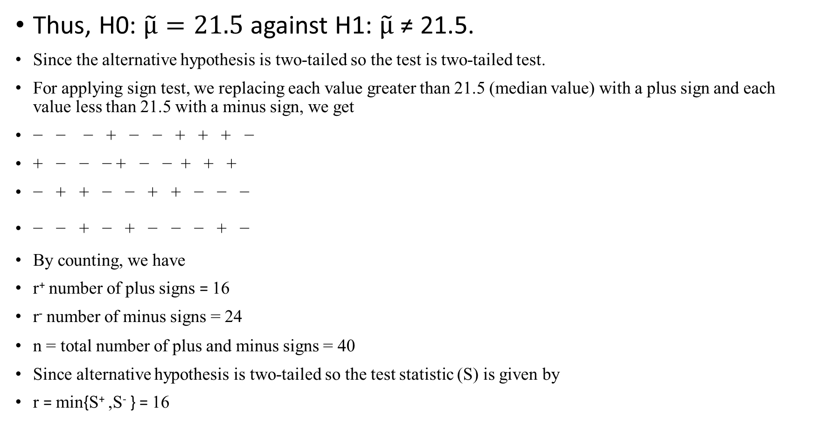
Thus, H0: $\tilde{μ}=21.5$ against H1: $\tilde{μ}$ ≠ 21.5.
Since the alternative hypothesis is two-tailed so the test is two-tailed test.
For applying sign test, we replacing each value greater than 21.5 (median value) with a plus sign and each value less than 21.5 with a minus sign, we get
− − − + − − + + + −
+ − − − + − − + + +
− + + − − + + − − −
− − + − + − − − + −
By counting, we have
r⁺ number of plus signs = 16
r⁻ number of minus signs = 24
n = total number of plus and minus signs = 40
Since alternative hypothesis is two-tailed so the test statistic (S) is given by
r = min{S⁺ ,S⁻ } = 16

Slide 13
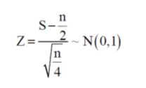
Here, n = 40 (> 20), so it is a case of large sample. In this case, we use Z-test.
The test statistic of Z-test is given by
= - 1.27
The critical (tabulated) values for two-tailed test at 1% level of significance are
± zα/2 = ± z0.005 = ± 2.58.
Since calculated value of Z (= −1.27) is greater than the critical value (= − 2.58) and less than the critical value (= 2.58), that means it lies in non-rejection region, so we do not reject the null hypothesis i.e. we support the claim at 1% level of significance.
=

Slide 14
Decision according to p-value
Since test is two-tailed, therefore,
p-value = 2P[Z ≥ |z| ] = 2P[Z ≥ 1.27]
= 2 [0.5 – P[0 ≤ Z ≤ 1.27]]
= 2(0.5 − 0.3980) = 0.204
Since p-value (= 0.204) is greater than 0.01, the level of significance, so we do not reject the null hypothesis i.e. we support the claim at1% level of significance.
Thus, we conclude that the sample fails to provide us sufficient evidence against the claim so we may assume that the median production of milk in dairies is 21.5 thousand kg.

Slide 15
Wilcoxon signed rank test

Slide 16
Wilcoxon signed rank test (Dependent Samples)
As for the sign test, the Wilcoxon signed rank sum test is used is used to test the null hypothesis that the median of a distribution is equal to some value. It can be used a) in place of a one-sample t-test b) in place of a paired t-test or c) for ordered categorial data where a numerical scale is inappropriate but where it is possible to rank the observations.
Assumptions
The random variable X is continuous
The probability density function of X is symmetric

Slide 17
Carrying out the Wilcoxon signed rank sum test

Slide 19
Numerical Example
Child | Before Treatment | After 1 Week of Treatment
1 | 85 | 75
2 | 70 | 50
3 | 40 | 50
4 | 65 | 40
5 | 80 | 20
6 | 75 | 65
7 | 55 | 40
8 | 20 | 25
This study assesses the effectiveness of a new drug designed to reduce repetitive behaviors in children affected with autism. A total of 8 children with autism enroll in the study and the amount of time that each child is engaged in repetitive behavior during three hour observation periods are measured both before treatment and then again after taking the new medication for a period of 1 week.

Slide 20
First, we compute difference scores for each child.
Child | Before Treatment | After 1 Week of Treatment | Difference (Before-After)
1 | 85 | 75 | 10
2 | 70 | 50 | 20
3 | 40 | 50 | -10
4 | 65 | 40 | 25
5 | 80 | 20 | 60
6 | 75 | 65 | 10
7 | 55 | 40 | 15
8 | 20 | 25 | -5
The next step is to rank the difference scores. We first order the absolute values of the difference scores and assign rank from 1 through n to the smallest through largest absolute values of the difference scores, and assign the mean rank when there are ties in the absolute values of the difference scores.

Slide 21
The final step is to attach the signs ("+" or "-") of the observed differences to each rank as shown below.
Observed Differences |  | Ordered Absolute Values of Differences | Ranks
10 |  | -5 | 1
20 |  | 10 | 3
-10 |  | -10 | 3
25 |  | 10 | 3
60 |  | 15 | 5
10 |  | 20 | 6
15 |  | 25 | 7
-5 |  | 60 | 8
Observed Differences |  | Ordered Absolute Values of Difference Scores | Ranks | Signed Ranks
10 |  | -5 | 1 | -1
20 |  | 10 | 3 | 3
-10 |  | -10 | 3 | -3
25 |  | 10 | 3 | 3
60 |  | 15 | 5 | 5
10 |  | 20 | 6 | 6
15 |  | 25 | 7 | 7
-5 |  | 60 | 8 | 8

Slide 22
H₀: The median difference is zero versus
H₁: The median difference is positive α=0.05
Here, n = 8, W+ = 32 and W- = 4
The test statistic is W = min(32,4)= 4.
The critical value of W is 5 and the decision rule is to reject H₀ if W < 5. Thus, we reject H₀, because 4 < 5.
We have statistically significant evidence at α =0.05, to show that the median difference is positive (i.e., that repetitive behavior improves.)

Slide 24
Example

